Slide 2
Decision Trees & Ensemble Models
Lecture 4

Slide 3
Course Schedule
Lecture 1: Introduction to Tree-Based Method
Lecture 2: Bias-Variance Tradeoff and Ensembling Approaches
Lecture 3: Bootstrap sampling
Lecture 4: Random Forests
Lecture 5: Boosting
Lecture 6: Project Presentation

Slide 4
Agenda
Class review
Random Forest Proximities
Feature Importances in Trees
Feature Importances in Forests
Summary

Slide 5
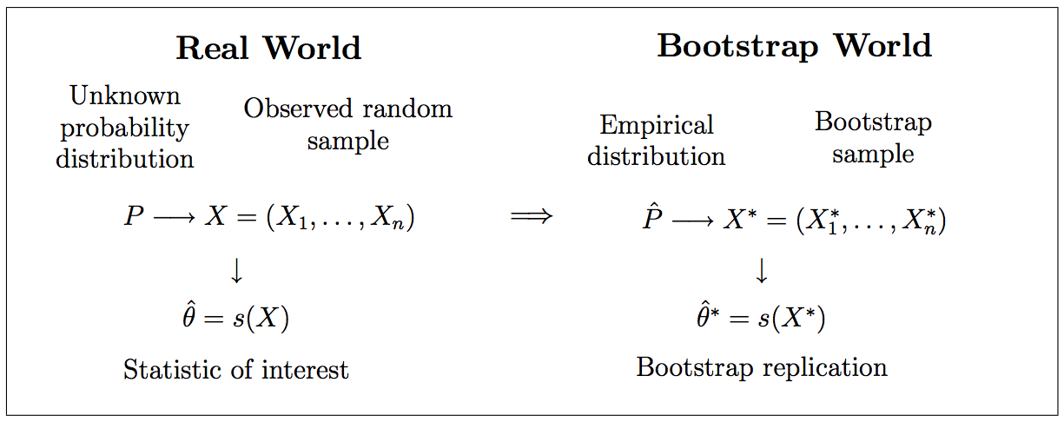
Bootstrapping

Slide 6
Bootstrap Aggregating: Bagging
Given a dataset D with n samples in it
Separate it into m different random samples with replacement: D_{m}
These may have a smaller number of points if desired
Train m models f_{m} on the sampled datasets D_{m}
Produce the final prediction by either averaging f_{m} (for regression problems) or voting with f_{m} (for classification problems)

Slide 7
Random Forest – Core Idea
What if we don’t just randomize the datapoints given to each tree, but the features as well.
Intuitively: if different trees trained on different features in different data all agree on the same conclusion, we can be very confident on the conclusion!
This can all be viewed through the Bias-Variance trade-off, and how successfully our added randomness can be averaged out.

Slide 8
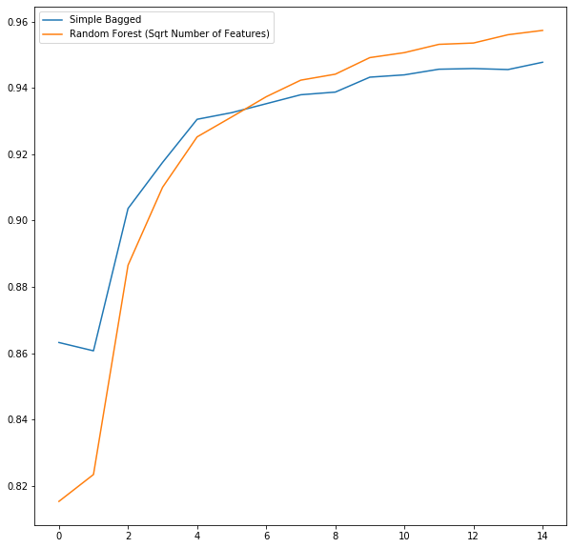
Main Takeaway
It works better than simply bagging trees
It is vastly more computationally efficient.
Each tree in the forest does a bit worse than in the bag, but the aggregate is better.
Test Accuracy
DTE-LECTURE-3-RANDOM-FOREST.ipynb
Number of predictors

Slide 9
Today’s Goal
We now turn to spending today examining the benefits we get by using random forests.

Slide 10
Agenda
Class review
Random Forest Proximities
Feature Importances in Trees
Feature Importances in Forests
Summary

Slide 11
Proximities: What are the Goals?
We normally think of a random forest as a method for using trees to make classifications (or predictions in the case of regression), but it is much more than that!
A random forest can be viewed as a highly non-linear method for transforming input features into output features (the leaves in all the trees where the data ended up) where the output features are known to be highly informative for the classification problem at hand.
Thus it can be a method of data transformation that can be combined with other techniques.
Let’s first examine combining with dimension reduction. To see how random forests can help illustrate the structure of complex datasets.

Slide 12
Random Forest Similarities
Suppose you are handed a two data points and you want to know how similar they are, imagine running both through a random forest that has 5 trees:
Data Point 1
Data Point 2

Slide 13
Random Forest Similarities
We will encode this by one-hot encoding which leaf they hit in each tree.
Data Point 1
V1 = [0,0,0,1, 0,0,0,1, 0,1,0,0, 0,1,0, 0,1,0,0]
Data Point 2
V2 = [0,0,1,0, 0,0,0,1, 1,0,0,0, 0,1,0, 0,1,0,0]

Slide 14
Random Forest Similarities
We can use these vectors as an encoding of the structure of our data, as seen through the random forest:
V1 = [0,0,0,1, 0,0,0,1, 0,1,0,0, 0,1,0, 0,1,0,0]
V2 = [0,0,1,0, 0,0,0,1, 1,0,0,0, 0,1,0, 0,1,0,0]
The similarity of these two data points is taken to be the probability that two data points land in the same leaf averaged over all trees.

Slide 15
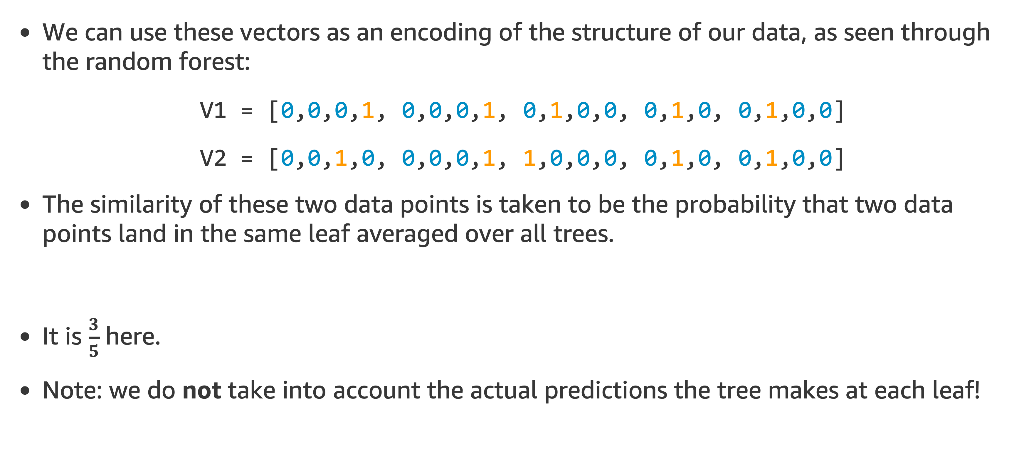
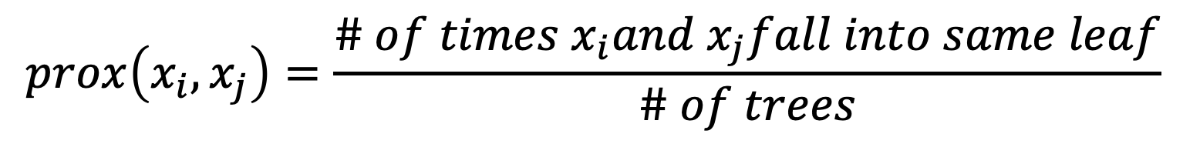
Random Forest Similarities
We can use these vectors as an encoding of the structure of our data, as seen through the random forest:
V1 = [0,0,0,1, 0,0,0,1, 0,1,0,0, 0,1,0, 0,1,0,0]
V2 = [0,0,1,0, 0,0,0,1, 1,0,0,0, 0,1,0, 0,1,0,0]
The similarity of these two data points is taken to be the probability that two data points land in the same leaf averaged over all trees.
It is $\frac{3}{5}$ here.
Note: we do not take into account the actual predictions the tree makes at each leaf!
$$prox\left(x_{i}, x_{j}\right)=\frac{\# of times x_{i}and x_{j}fall into same leaf}{\# of trees}$$

Slide 16
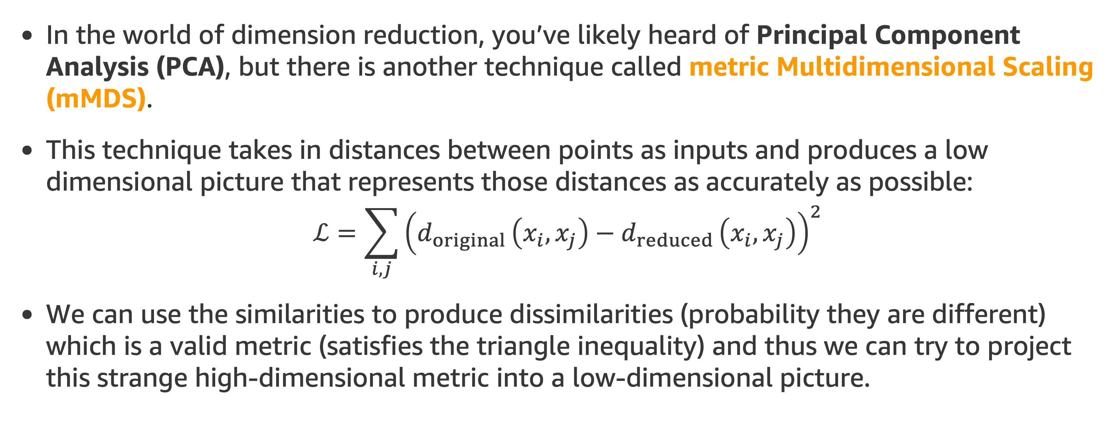
How do we use this?
In the world of dimension reduction, you’ve likely heard of Principal Component Analysis (PCA), but there is another technique called metric Multidimensional Scaling (mMDS).
This technique takes in distances between points as inputs and produces a low dimensional picture that represents those distances as accurately as possible:
$$ℒ=\sum_{i,j}{{\left(d_{original }\left(x_{i},x_{j}\right)−d_{reduced }\left(x_{i},x_{j}\right)\right)}^{2}}$$
We can use the similarities to produce dissimilarities (probability they are different) which is a valid metric (satisfies the triangle inequality) and thus we can try to project this strange high-dimensional metric into a low-dimensional picture.

Slide 17
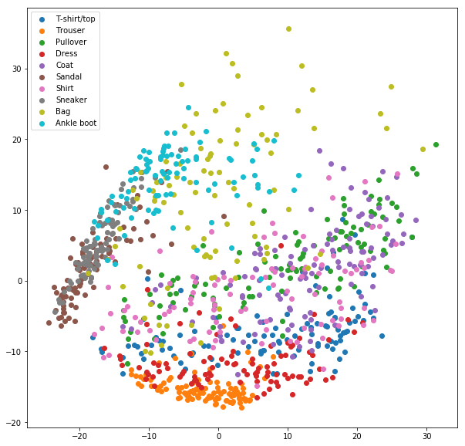
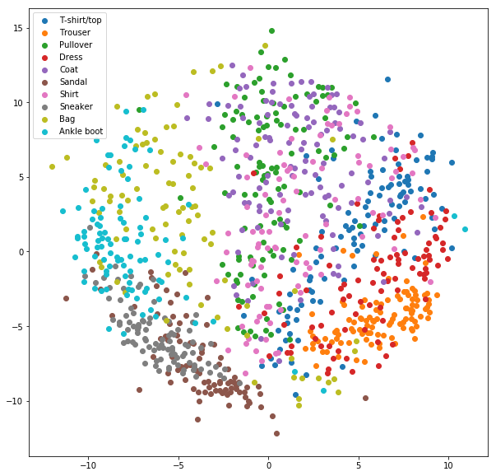
PCA and Metric MDS on Fashion MNIST
These two images show the raw PCA and Metric MDS on Fashion MNIST (we run on images, no proximities yet). Note that there is some structure, but very fuzzy.
PCA
MDS

Slide 18
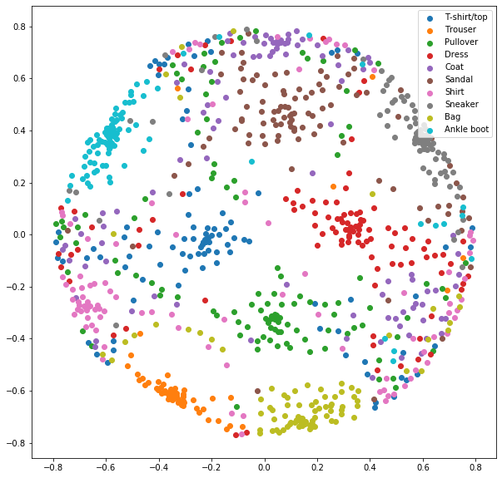
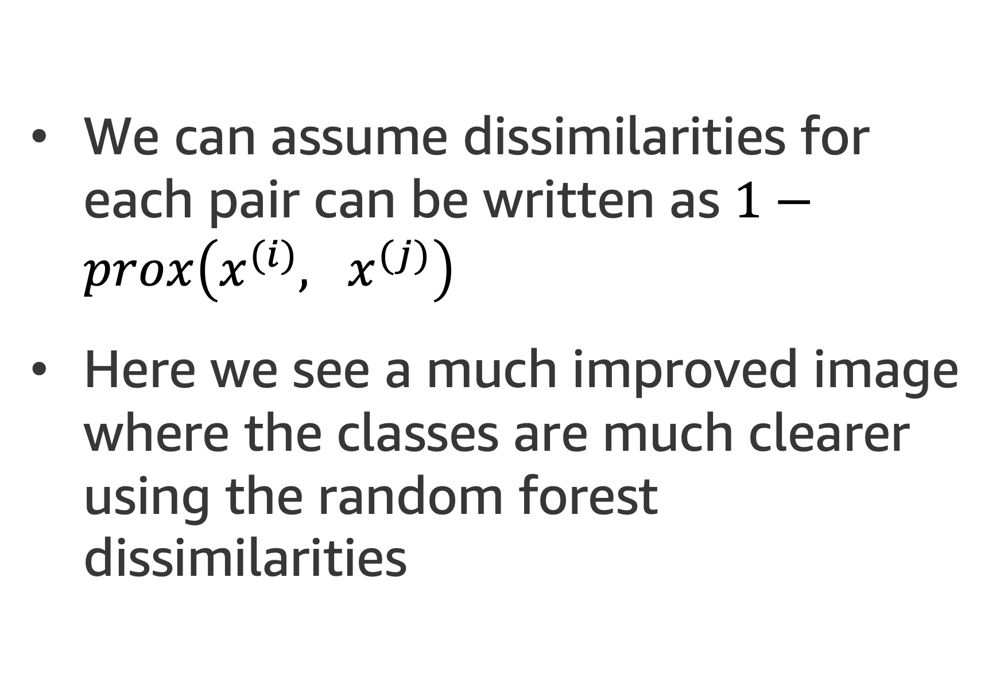
MDS of Dissimilarities
We can assume dissimilarities for each pair can be written as $1−prox\left(x^{(i)}, x^{(j)}\right)$
Here we see a much improved image where the classes are much clearer using the random forest dissimilarities
This is your homework

Slide 19
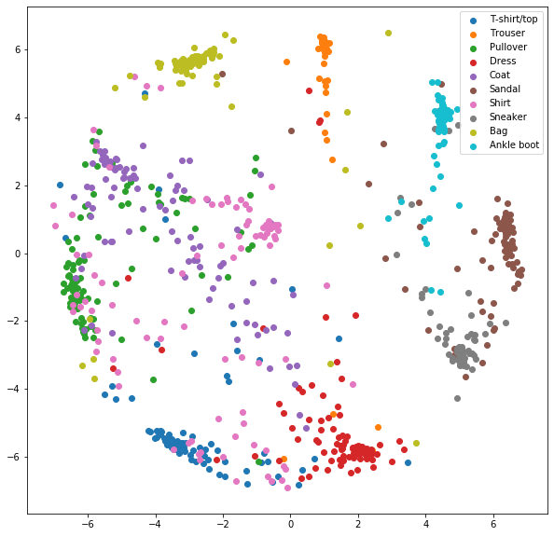
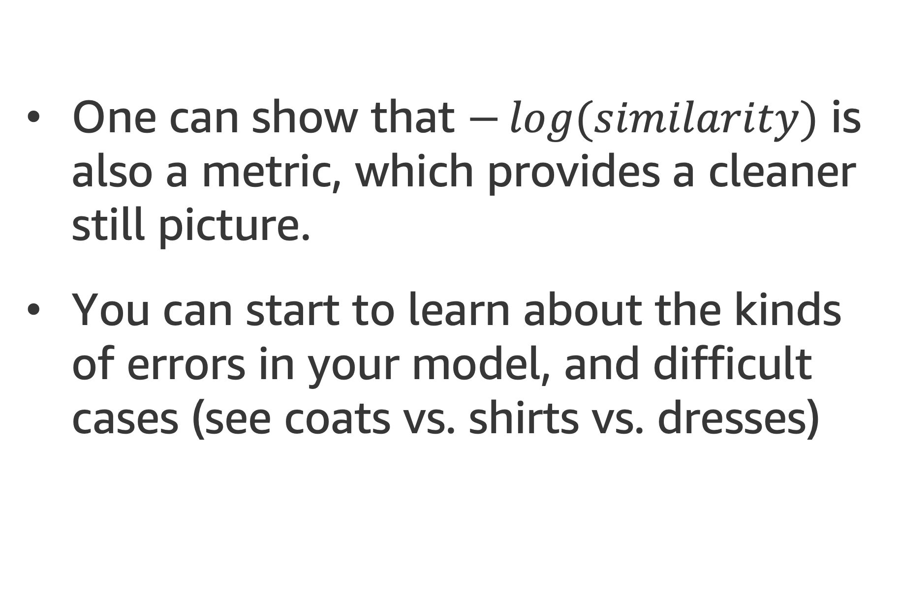
Can you do better?
One can show that $−\log{(similarity)}$ is also a metric, which provides a cleaner still picture.
You can start to learn about the kinds of errors in your model, and difficult cases (see coats vs. shirts vs. dresses)
This is your homework

Slide 20
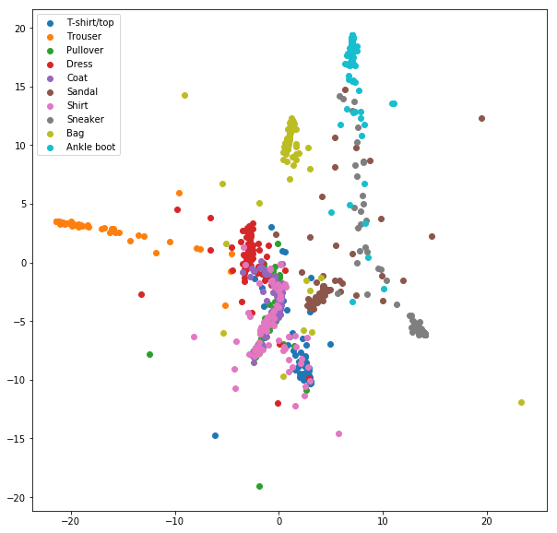
PCA of Vectors
You can also use the vectors themselves to expand out the data to a high dimensional space designed for easy discrimination, and then work there, here using PCA.

Slide 21
Can also feed other methods
You can take this expanded feature vector and use it as inputs to other ML techniques. Here I’ll discuss it on test accuracy on Fashion MNIST:
Random Forest: 85.5%
Logistic Regression: 84.15%
Logistic Regression on RF Features: 87.28%
As we can see, the combination improves over either one alone (not huge, but it can matter)!

Slide 22
Annoying Fact
Sklearn currently does not implement proximities, thus you need to implement them yourself.
So: homework!
Key component: The following returns the list of leaf indices for every tree in the forest applied to all rows of X.
RandomForestClassifier().apply(X)

Slide 23
Agenda
Review
Random Forest Proximities
Feature Importances in Trees
Feature Importances in Forests
Summary

Slide 24
Feature Importance
Tree based methods have a major benefit:
They are able to explicitly evaluate the importance of individual variables to the decision making process.
This can be used for variable selection, or as part of exploratory data analysis.

Slide 25
Feature importance in a Single Tree
We will discuss what is often referred to as Gini Importance or the Mean Impurity Decrease method of measuring importance.
Class 1
Class 2
Class 2
Data: 30%
Data: 20%
Data: 30%
Gini: 0.1
Gini: 0.1
Gini: 0.1
X₁ > 0.5
Data: 100%
Gini: 0.5
X₂ > 0.25
X₁ > 0.25
Class 1
Data: 70%
Data: 50%
Data: 20%
Gini: 0.3
Gini: 0.2
Gini: 0.1

Slide 26
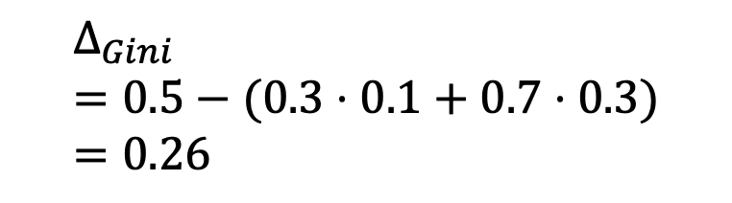
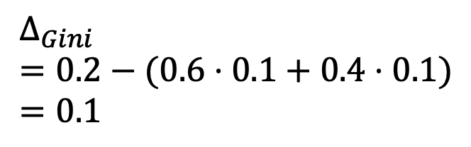
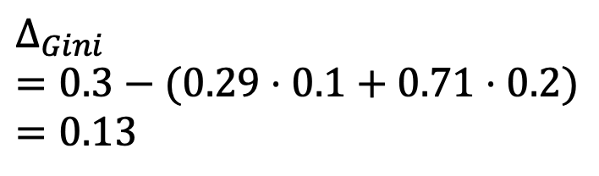
Feature importance in a Single Tree
We can label every node with the average decrease in Gini Impurity that occurs at that node.
Class 1
Class 2
Class 2
Data: 30%
Data: 20%
Data: 30%
30%
Gini: 0.1
Gini: 0.1
Gini: 0.1
X₁ > 0.5
29%
60%
Data: 100%
$$∆_{Gini}=0.3−(0.29⋅0.1+0.71⋅0.2)=0.13$$
$$∆_{Gini}=0.2−(0.6⋅0.1+0.4⋅0.1)=0.1$$
Gini: 0.5
$$∆_{Gini} \\ =0.5−(0.3⋅0.1+0.7⋅0.3)=0.26$$
70%
X₂ > 0.25
X₁ > 0.25
Class 1
Data: 70%
Data: 50%
40%
Data: 20%
Gini: 0.3
71%
Gini: 0.2
Gini: 0.1

Slide 27
Feature importance in a Single Tree
Recall that as the tree was built, we picked the splits to maximize the change in the Gini impurity.
Thus to every node in the tree we have associated to it the change in impurity from that particular split.
We can associate to every feature a decrease in impurity as follows:
For every node associated to that feature, add up the fraction of the data that passes through that node times the reduction in Gini impurity at that node (formula in the next slide)
This defines the feature importance

Slide 28
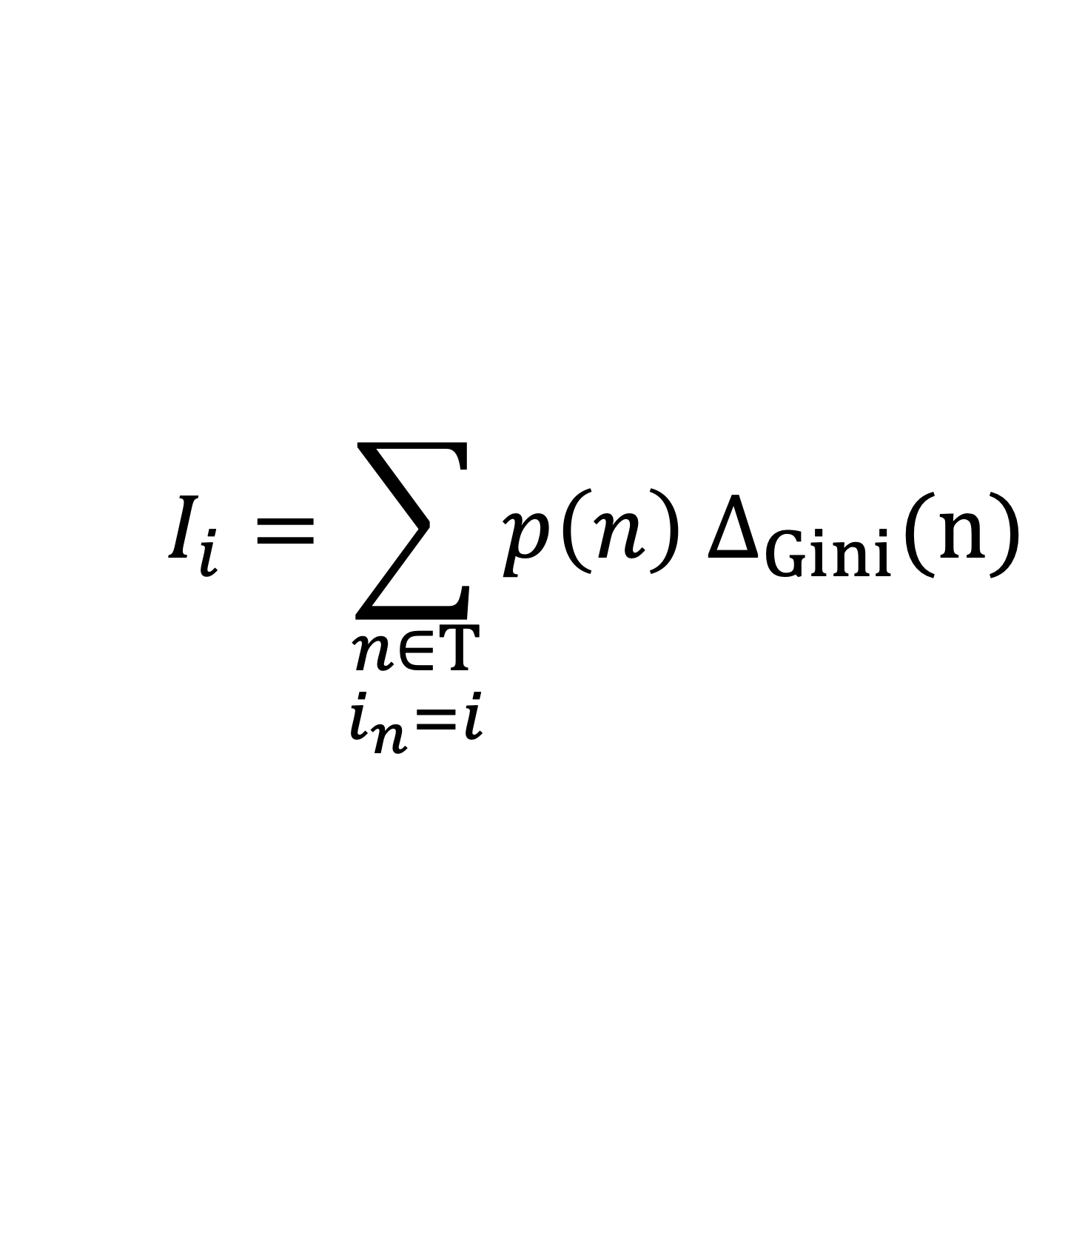
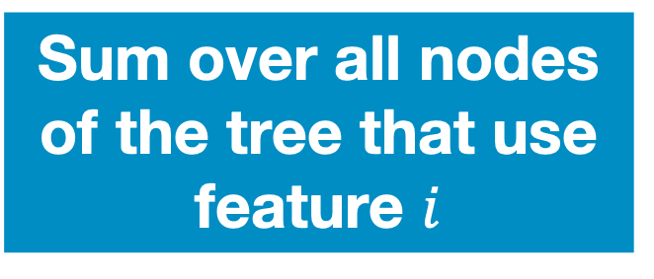

Feature importance in a Single Tree
In formula this is:
$$I_{i}=\sum_{\begin{aligned}n∈T \\ i_{n}=i\end{aligned}}{p\left(n\right) Δ_{Gini}(n)}$$
Change in Gini Impurity at that node
Importance of feature $i$
Probability of using that node
Sum over all nodes of the tree that use feature $i$

Slide 29

Feature importance in a Single Tree
We can label every node with the average decrease in Gini Impurity that occurs at that node.
$$I_{1}=1.0⋅0.26+0.5⋅0.1 =0.31$$
$I_{2}=0.7⋅0.13$= 0.09
Class 1
Class 2
Class 2
Data: 30%
Data: 20%
Data: 30%
30%
Gini: 0.1
Gini: 0.1
Gini: 0.1
X₁ > 0.5
29%
60%
Data: 100%
$$∆_{Gini}=0.3−(0.29⋅0.1+0.71⋅0.2)=0.13$$
$$∆_{Gini}=0.2−(0.6⋅0.1+0.4⋅0.1)=0.1$$
Gini: 0.5
$$∆_{Gini} \\ =0.5−(0.3⋅0.1+0.7⋅0.3)=0.26$$
70%
X₂ > 0.25
X₁ > 0.25
Class 1
Data: 70%
Data: 50%
40%
Data: 20%
Gini: 0.3
71%
Gini: 0.2
Gini: 0.1

Slide 30
Feature importance in a Single Tree
These importances tell you the relative importance of the two features:
Importance of X₁ = 0.31
Importance of X₂ = 0.09
This makes sense if you plot the decision the tree makes:
X₂
2
1
X₁ has a much larger impact on the final class than X₂
1
X₁

Slide 31
Limitations of the Tree Feature Importance
1- Depends on tree not prediction (two trees that make the same predictions can have different importances)
2- Can become confused with correlated variables (if one is slightly more informative than another, it might be used exclusively even though both are almost equally useful)

Slide 32
1-Depends on Tree: An Illustrative Failure Case
Suppose you are trying to learn a tree for the XOR classification problem on the right.
Note: The greedy growth of trees has some issue with this since the impurity is unchanged with any first split, but after that it is fine.
If you consider the two obvious trees, the feature importances for these trees are either entirely on the first component or entirely on the second!
2
1
x₂
1
2
x₁

Slide 33
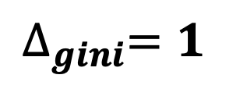
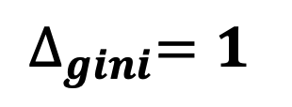
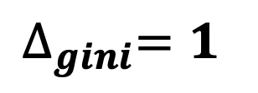
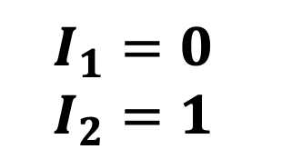
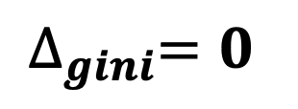
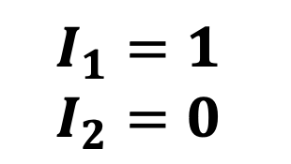
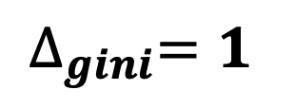
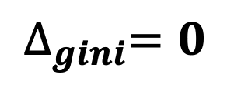
1-Depends on Tree: An Illustrative Failure Case
Suppose you are trying to learn a tree for the XOR classification problem on the right.
Note: The greedy growth of trees has some issue with this since the impurity is unchanged with any first split, but after that it is fine.
If you consider the two obvious trees, the feature importances for these trees are either entirely on the first component or entirely on the second!
2
1
x₂
1
2
x₁
$$∆_{gini}=1$$
yes
1
$$∆_{gini}=1$$
yes
1
yes
x₂ > 0.5
$$I_{1}=0$$
$$I_{2}=1$$
yes
x₁ > 0.5
$$I_{1}=1$$
$$I_{2}=0$$
x₁ > 0.5
no
2
x₂ > 0.5
no
2
$$∆_{gini}=0$$
no
yes
2
$$∆_{gini}=0$$
no
yes
2
x₂ > 0.5
x₁ > 0.5
$$∆_{gini}=1$$
no
1
$$∆_{gini}=1$$
no
1

Slide 34
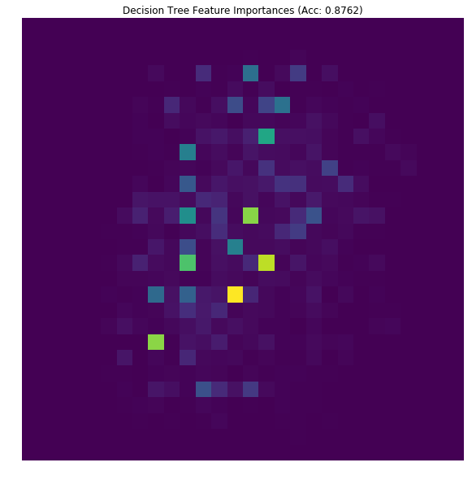
2-Correlated Variables: Feature Importance on MNIST
Image data is highly correlated, so it can show that second point very clearly, where predictions are dominated by a small number of pixels
DTE-LECTURE-4-FEATURE-IMPORTANCE.ipynb

Slide 35
Agenda
Review
Random Forest Proximities
Feature Importances in Trees
Feature Importances in Forests
Summary

Slide 36
How Random Forests Help solve these Issues
Depends on tree not prediction/data
Due to random data split, the different equivalent should hopefully all occur equally; often all contributing to the importance
Can become confused with correlated variables (if one is slightly more informative than another, it might be used exclusively even though both are almost equally useful)
Random feature split means that different trees will have access to different subsets of the the correlated variables. Thus each variable will contribute!

Slide 37
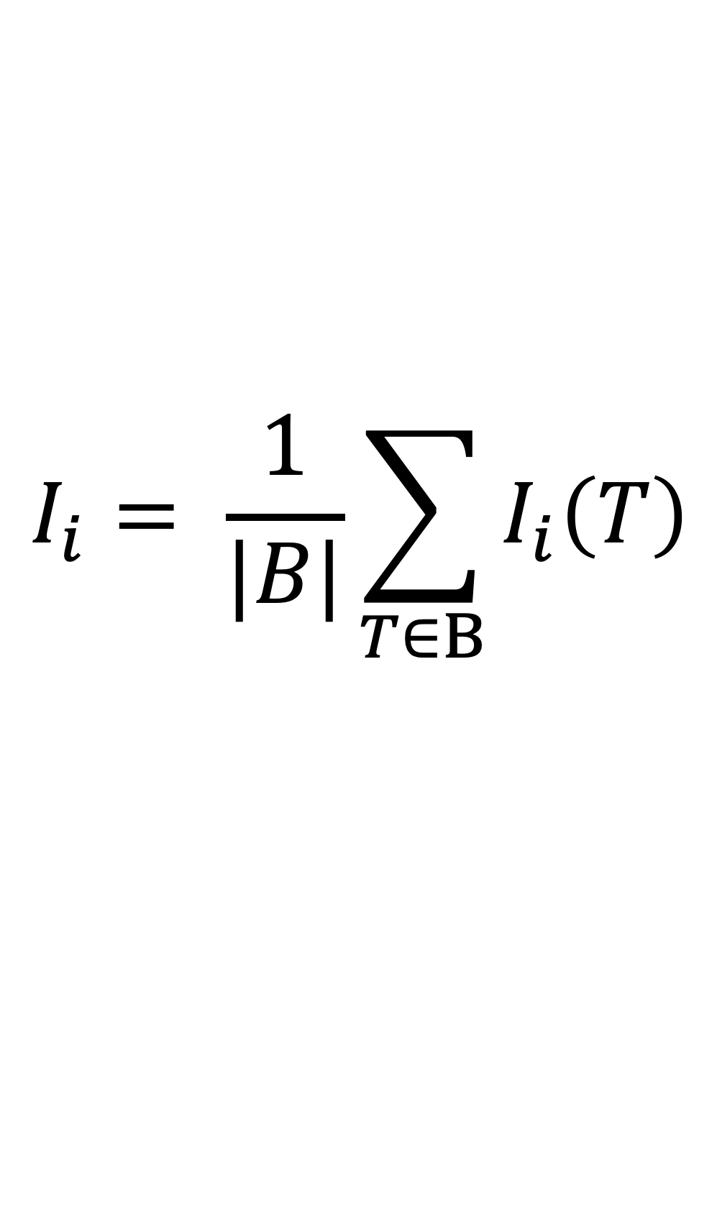
Feature Importance - Formula
We simply average over all the trees in the forest the importance from that tree.
$$I_{i}= \frac{1}{|B|}\sum_{T∈B}{I_{i}\left(T\right)}$$

Slide 38
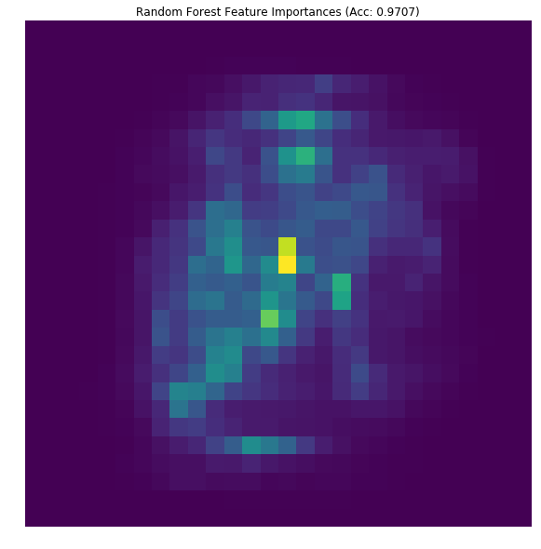
Feature Importance Example on MNIST
We can now see how working with importances in random forests can help smooth things out to a more reasonable model
Remember it does this while still being faster to train, and more accurate
DTE-LECTURE-4-FEATURE-IMPORTANCE.ipynb

Slide 39
Warnings about Feature Importances
Interpreting feature importances can be wrought with peril. Here are a few warnings:
Main one: continuous random variables are often seen as more important than discrete. Discrete ones with more classes are more important than discrete ones with fewer classes. This paper dives in, as does this blog.
Consequence: often times a random continuous column is seen as more important than an informative discrete one!
Collinearity: Correlated columns will share feature importance between them (imagine duplicating a column, the random forests will pick the columns essentially at random, spreading the importance)

Slide 40
Permutation Importance
In general feature importances can be computed using whatever criteria you used to split: entropy, Gini, mean squared error.
An alternative notion, called Permutation Importance, can also be used:
First the random forest is grown and the out-of-bag error (or validation error) is used to assess the performance of the model
Second, the i-th feature is randomly shuffled in the out-of-bag samples (or validation samples), and the accuracy on the shuffled features is also measured.
The decrease in accuracy when the feature is shuffled is the importance of the feature
Note that this makes sense for any model, not just trees.
It is extremely slow

Slide 41
Permutation Importances on MNIST
If done with a small number of shuffles (here 10 for efficiency) they can be fairly noisy
Generally shows a similar pattern to the Gini Importance
Great discussion here on the benefits.
Again, often very inefficient. This noisy picture took 1 hour, the last one took 1 minute…
DTE-LECTURE-4-PERMUTATION-FEATURE-IMP.ipynb

Slide 42
Agenda
Review
Random Forest Proximities
Feature Importances in Trees
Feature Importances in Forests
Summary

Slide 43
Summary
Saw how to further boost the performance of bagged trees by taking random subsets of features as well, leading us to random forests
Saw how to compute feature importances in trees and forests, and noted that there were some shortfalls when working with trees that we could avoid by moving to forests

Slide 44
Next Time
Aggregating trees in parallel on data is nice, it allows us to reduce variance with a small tradeoff in bias
It would be nice if we could also somehow do the opposite: aggregate models to reduce bias without introducing too much variance
Boosting is a tool that lets us do exactly this!

Slide 45
Final Project – Predict Pet Adoption Time
You will working with pet adoption data from Austin Animal Center.
We joined two datasets that cover intake and outcome of animals. Intake data is available from here and outcome is from here.
We want you to predict whether a pet is adopted within the 30 days stay time in the animal center.
We give you a starter notebook: DTE-FINAL-PROJECT.ipynb
Dataset schema:
Pet ID - Unique ID of pet
Outcome Type - State of pet at the time of recording the outcome
Sex upon Outcome - Sex of pet at outcome
Name - Name of pet
Found Location - Found location of pet before entered the center
Intake Type - Circumstances bringing the pet to the center
Intake Condition - Health condition of pet when entered the center
Pet Type - Type of pet
Sex upon Intake - Sex of pet when entered the center
Breed - Breed of pet
Color - Color of pet
Age upon Intake Days - Age of pet when entered the center (days)
Time at Center - Time at center (0 = less than 30 days; 1 = more than 30 days). This is the value to predict.

Slide 46
Libraries-tools and licenses
Numpy: BSD
Pandas: BSD
Sagemaker: Apache license 2.0
Seaborn: BSD
Sklearn: BSD
Matplotlib: BSD
CatBoost: Apache license 2.0
LightGBM: MIT
XGBoost: Apache license 2.0
MXNet: Apache license 2.0

